Slide 1
Tool manual for DBI flash generator
2021.11.22

Slide 2
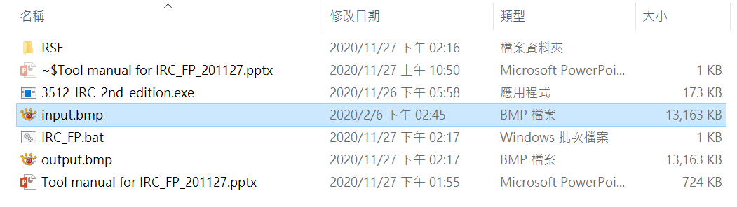
Step 1. Input pattern
You can change input picture at the same root. (But the pattern format should be “bmp” or “ppm”)
If there is "input picture", this tool will generate bin file according to mode 0, otherwise mode 1.
Mode 0: generate bin file based on input picture
Mode 1: generate bin file based on input settings
Note: If panel resolution is “Width” x “Height”,
then the size of input picture should be “Width/8” x “Height/8”.

Slide 3
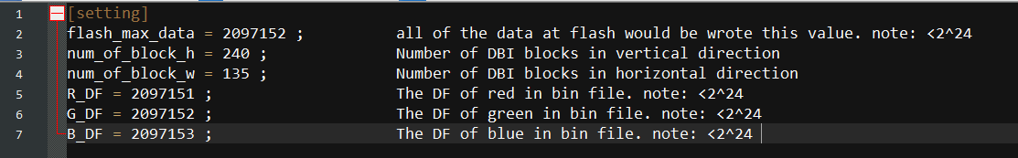
Step 2. Register setting
First, open register file: Root→ \ regist_interface.ini
Then, modify register setting by different test condition.
The max. value at flash data for mode 0.
The REG settings for mode 1.

Slide 4
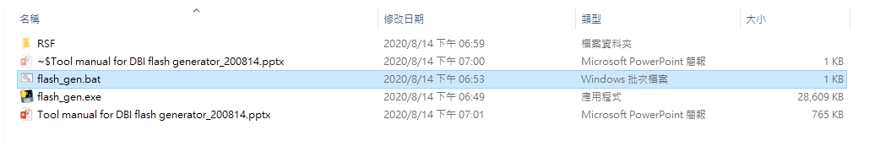
Step 3. Execute function
Double click “flash_gen.bat”

Slide 5
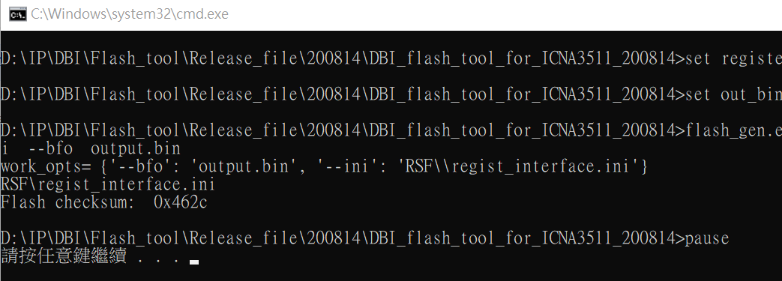
Step 4. CMD window
You can find the flash checksum at cmd window.

Slide 6
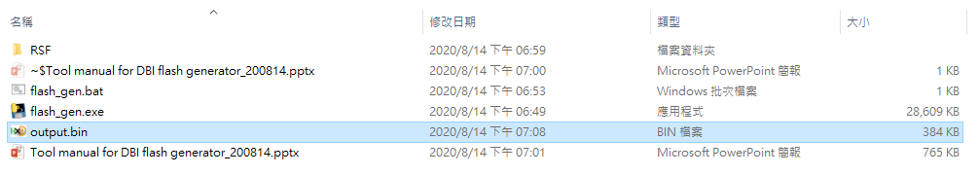
Step 5. Output file
After “flash_gen.bat” is finish, the following file would be generated.
output.bin → the flash bin file for DBI using.

Slide 7
谢谢 ! Thank you!

